Slide 1
PYRAMINX…..The Untold Story..
Karan Chadha - 140070014
Kalpesh Krishna - 140070017
Roshan Nayak - 140040097
Harita Parmar - 140110014

Slide 2
Problem Statement
To detect colors of stickers of pyraminx using image processing and send this data to computer .
To find fastest solution to that pyraminx.
To generate scrambling algorithms and implement GUI to solve the pyraminx.
To provide analysis on the user solve.
To generate cubing algorithms for tasks on pyraminx. And to implement the GUI for the same.

Slide 3
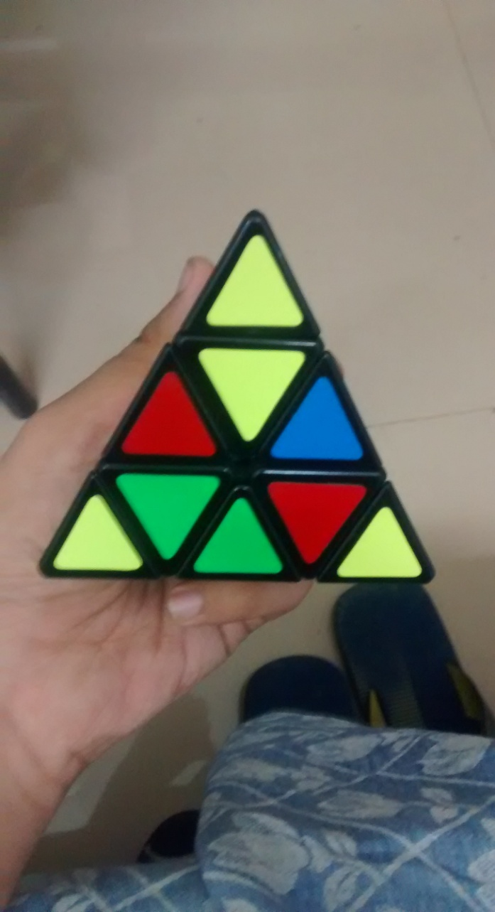
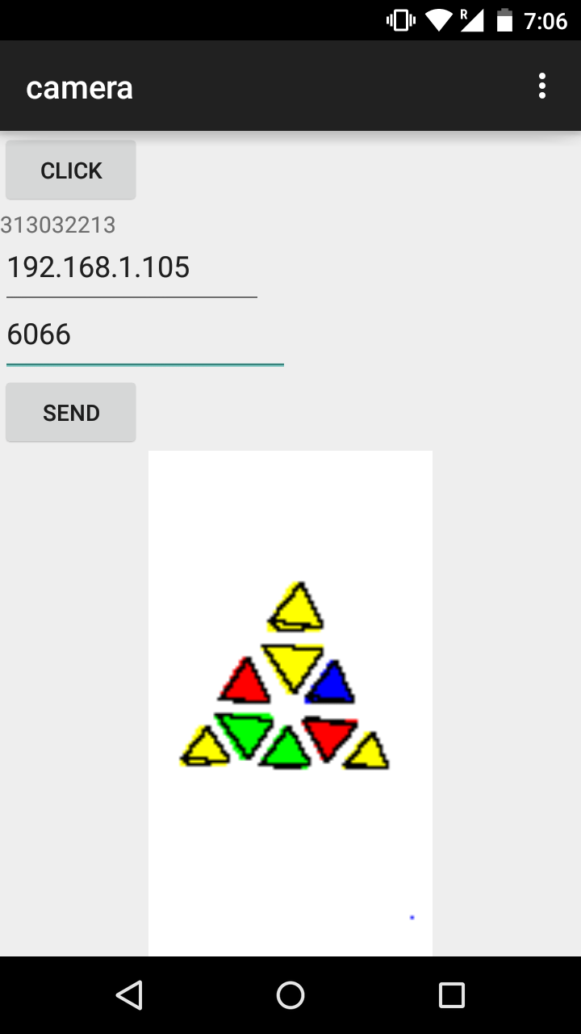
Android app and Image processing

Slide 4
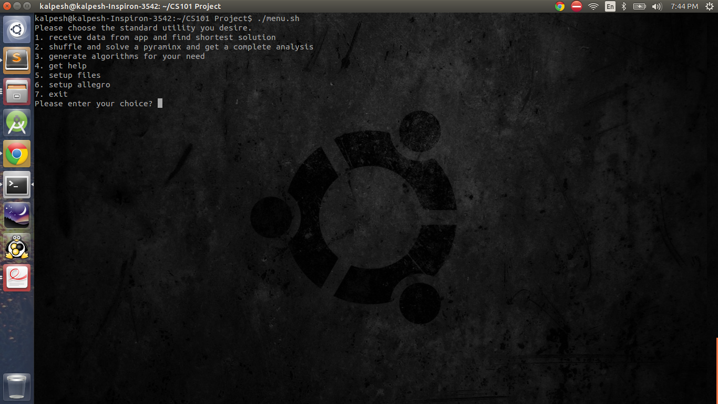
Menu script

Slide 5
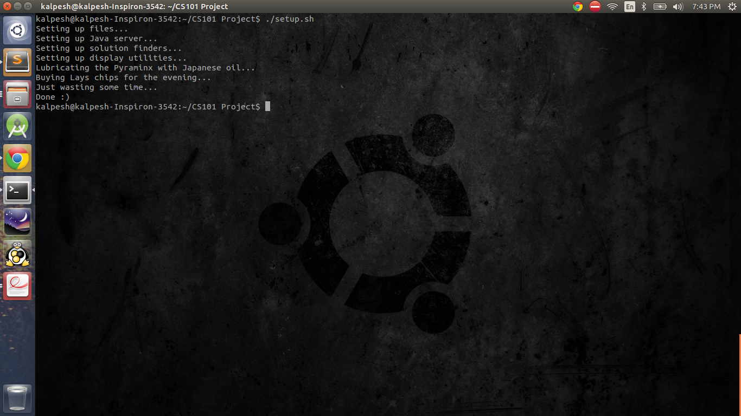
Setup Script

Slide 6
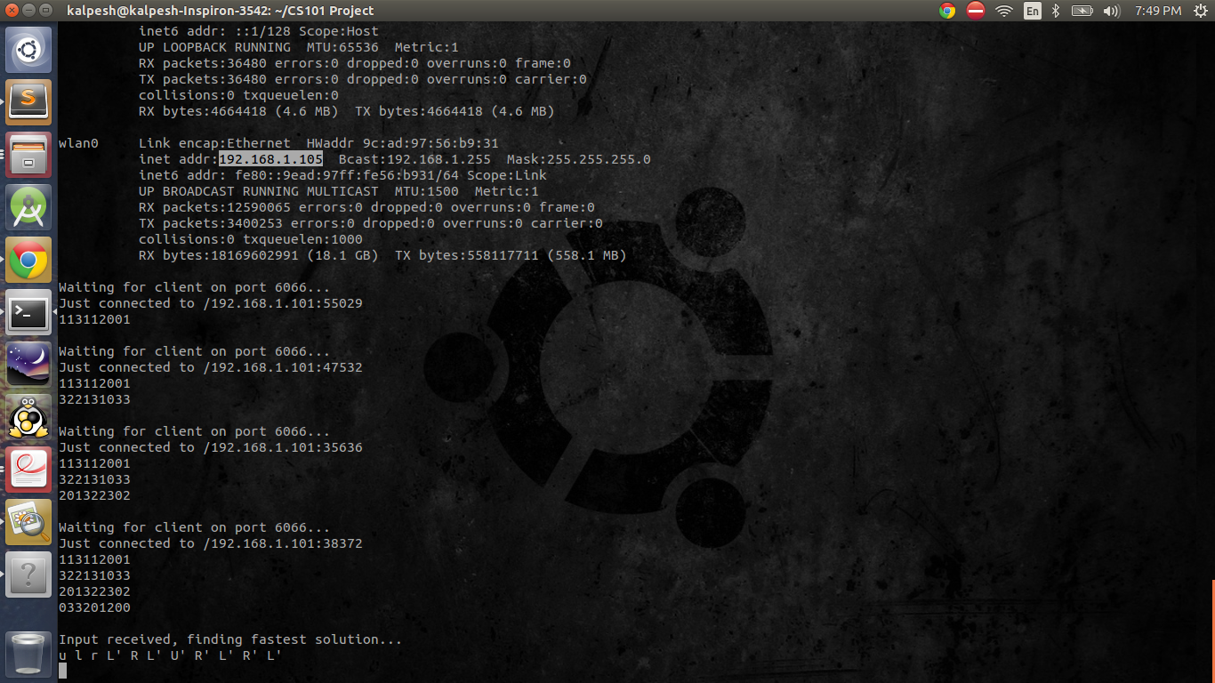
Mode-1 IP Receiver

Slide 7
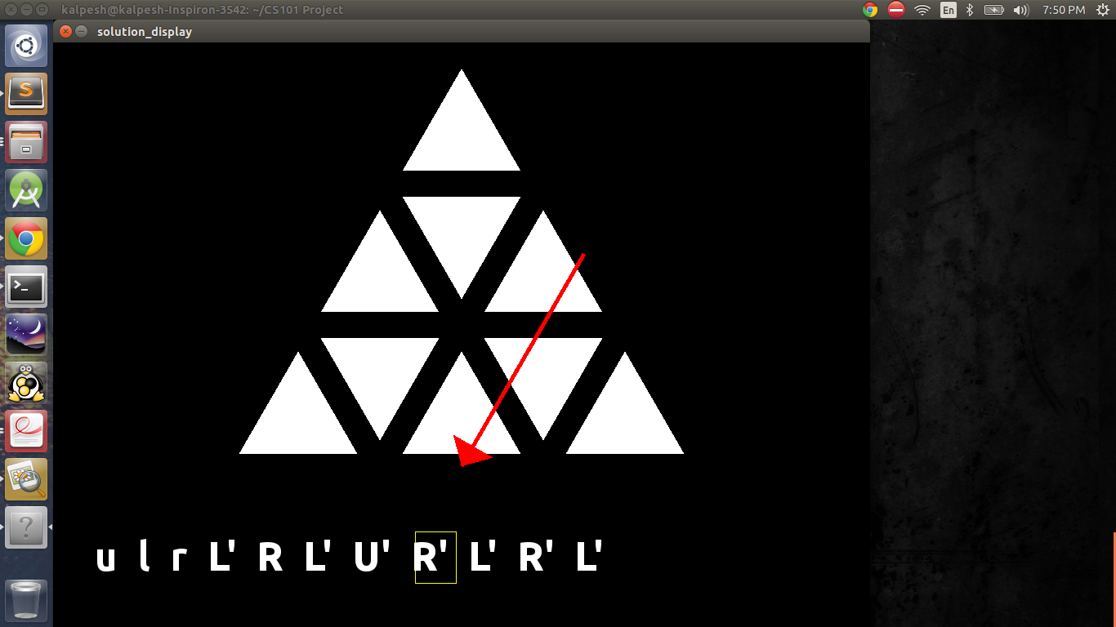
Solution Display

Slide 8
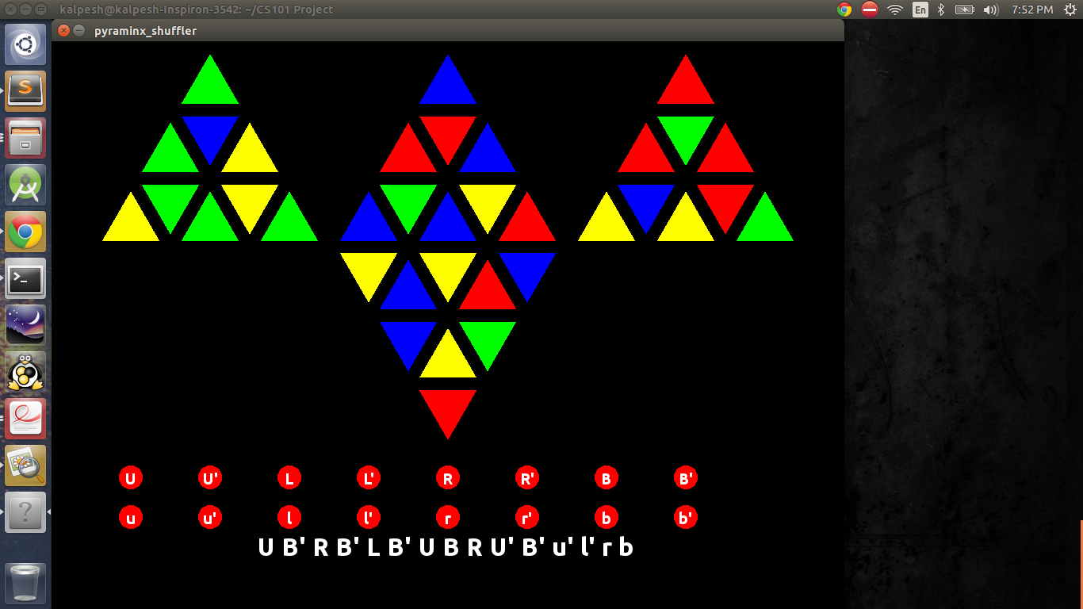
Pyraminx Shuffler GUI

Slide 9
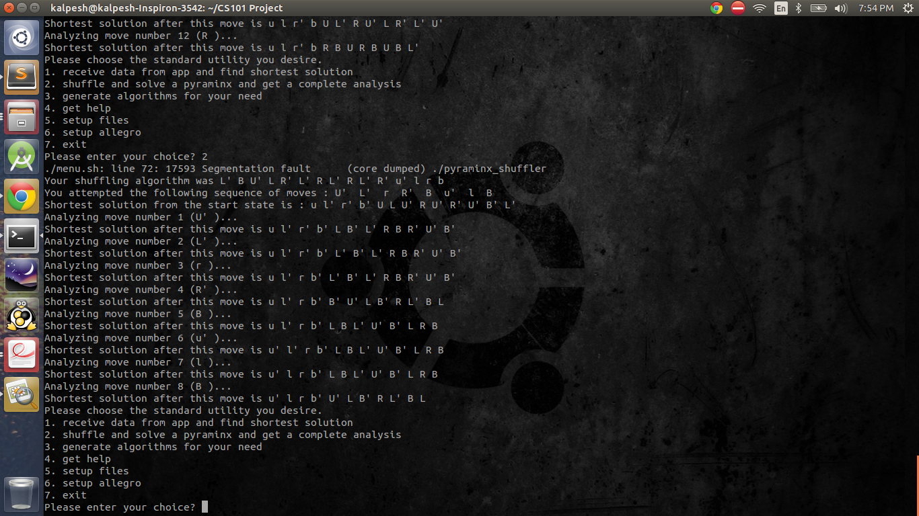
Mode-2 Analysis

Slide 10
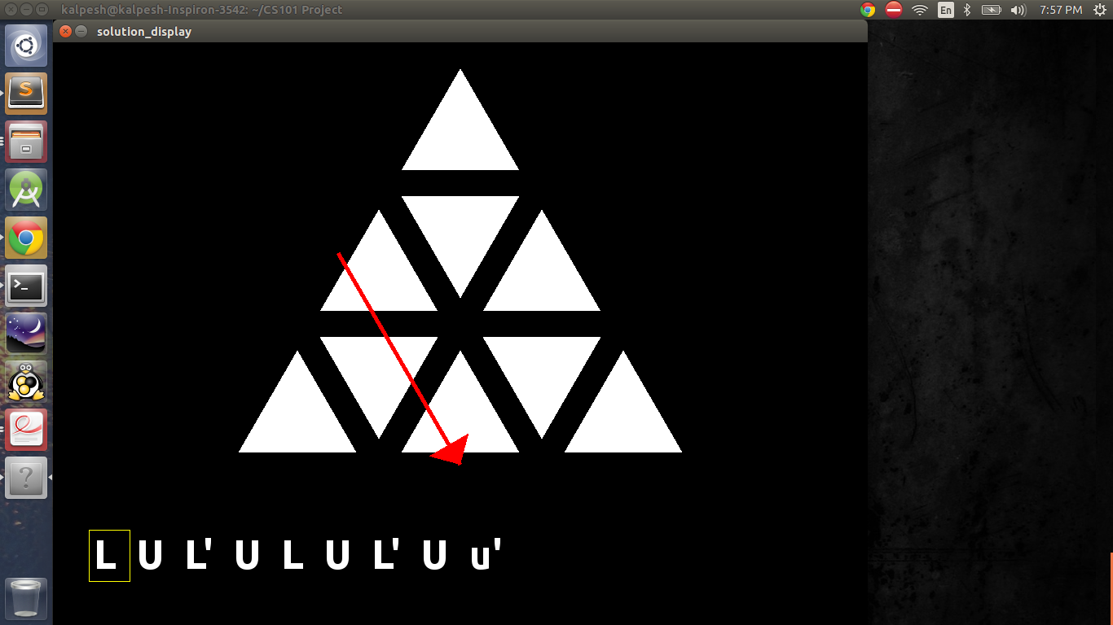
Mode-3 Algorithm Display

Slide 11
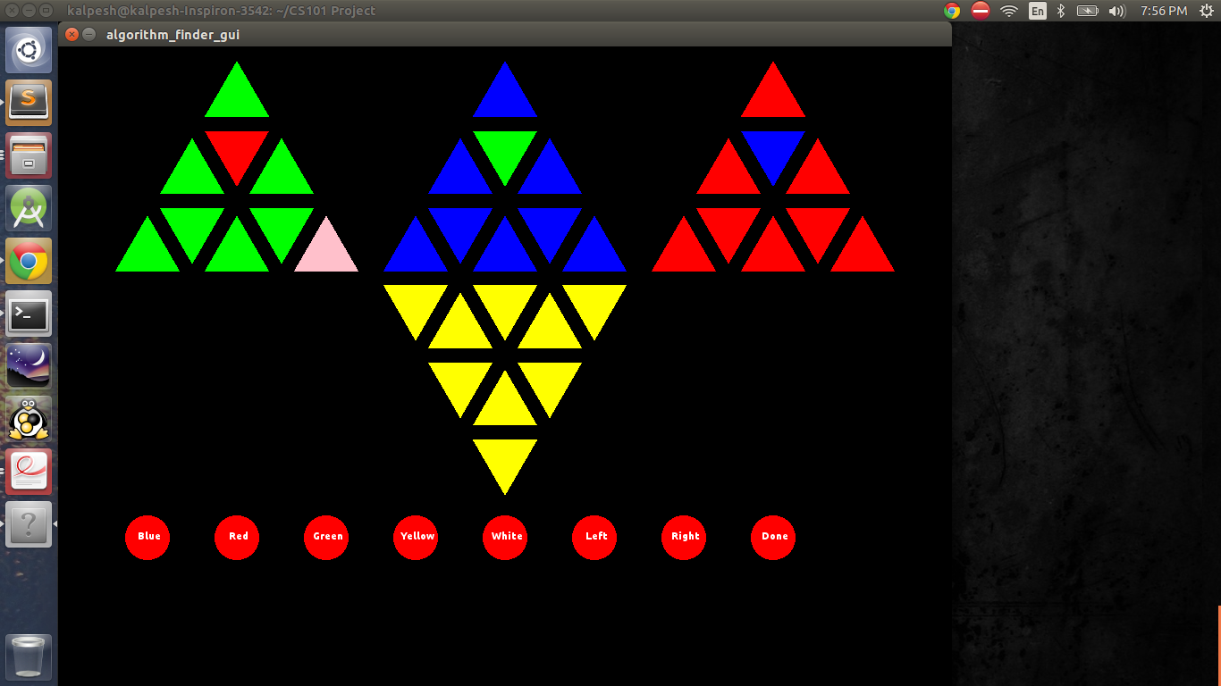
Algorithm finder GUI

Slide 12
Challenge
The time taken for BFS algorithm was more than a day , this was rectified by changing data structure used . We changed simple array based implementation to the Binary search tree implementation and used AVL to balanced th trees. This reduced many steps from O(n) to O(log n) and time reduced to 15 seconds in worst case scenario and 4 seconds on an average.

Slide 13
Future work
We can improve algorithm finder by adding links between stickers .
Implement 3-D pyraminx .
Change menu bar from a bash script to a GUI .
Improve interface for Android app.

